Slide 1
Chapter 17: Using SMP/E
Notes:
In this lecture, we’ll discuss the process for installing and updating the software in a z/OS system. SMP/E is the z/OS tool for managing the installation of software products on a z/OS system and for tracking modifications to those products.

Slide 2
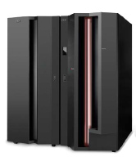
Chapter objectives
After completing this chapter, you will be able to explain:
What SMP/E is
What system modifications are
The data sets used by SMP/E
How SMP/E can help you install and maintain products, and monitor changes to products
Notes:
As a z/OS system programmer, it will be your responsibility to ensure that all software products and their modifications are properly installed on the system. You will also have to ensure that all products are installed at the proper level so that the elements of the system can work together. At first, that might not sound too difficult, but as the complexity of the software configuration increases, so does the task of monitoring all the elements of the system.
SMP/E is the primary means of installing and updating the software in a z/OS system. SMP/E consolidates installation data, allows more flexibility in selecting changes to be installed, provides a dialog interface, and supports dynamic allocation of data sets.

Slide 3
Key terms in this chapter
ACCEPT
APPLY
authorized program analysis report (APAR)
consolidated service inventory (CSI)
distribution library (DLIB)
distribution zone
global zone
HOLDDATA
program temporary fix (PTF)
SYSMOD
target library
zone
Notes:
During this lecture, we’ll learn the meaning of these terms, which are central to the process of using SMP/E to manage changes on the system.

Slide 4
What is SMP/E?
SMP/E is the z/OS tool for managing the installation of software products on a z/OS system and to track modifications to those products.
SMP/E controls these changes at the component level by:
  Selecting the proper levels of code to be installed from a large number of potential changes
  Calling system utility programs to install the changes
  Keeping records of the installed changes by providing a facility to enable you to inquire on the status of your software and to reverse the change if necessary.
All code and its modifications are located in the SMP/E database called the consolidated software inventory (CSI), which is comprised of one or more VSAM data sets.
Notes:
SMP/E can be run either using batch jobs or using dialogs under ISPF/PDF. With SMP/E dialogs, you can interactively query the SMP/E database and create and submit jobs to process SMP/E commands.
Later in this lecture, we’ll briefly touch on the basic commands for working with SMP/E. These commands are described more fully in the IBM publication, SMP/E for z/OS Commands.
[Now might be a good time to remind students that the z/OS product manuals are available for download at the z/OS Internet Library Web site: http://www.ibm.com/servers/eserver/zseries/zos/bkserv/ ]

Slide 5
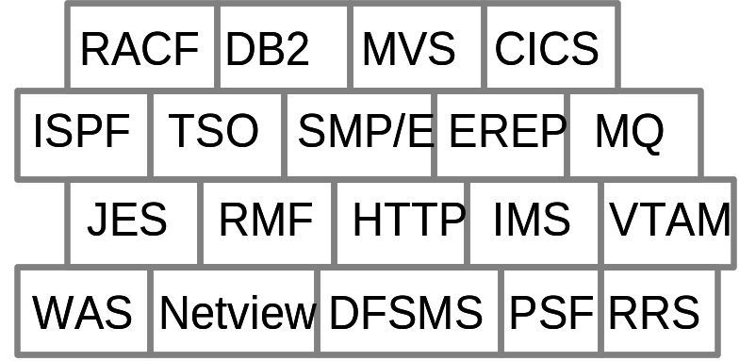
The SMP/E view of the system…
z/OS is a complex system comprising many different smaller blocks of code.
Each of those smaller blocks of code perform a specific function in the system.
Each system function is composed of one or more load modules.
Load modules are created by combining one or more object modules and processing them with a link-edit utility.
Notes:
A z/OS system might appear to be one big block of code that drives the CPU. Actually, z/OS is a complex system comprising many different smaller blocks of code. Each of those smaller blocks of code perform a specific function within the system. This slide shows just a few of the functions included in a typical z/OS system.
Each system function is composed of one or more load modules. In a z/OS environment, a load module represents the basic unit of machine-readable, executable code. Load modules are created by combining one or more object modules and processing them with a link-edit utility. The link-editing of modules is a process that resolves external references and addresses. The functions on your system, therefore, are one or more object modules that have been combined and link-edited.
Most of the time, object modules are sent to you as part of a product. Other times, you might need to assemble source code sent to you by product packagers to create the object module. You can modify the source code and then assemble it to produce an object module.
[The textbook shows an example: SRCMOD2 is source code that you assemble to create object module MOD2. When assembled, you link-edit object module MOD2 with object module MOD1 to form the load module LMOD1.]

Slide 6
Elements of the system
Besides object modules and source code, most products distribute many other parts such as macros, help-panels, CLISTs and other z/OS library members.
These modules, macros and other types of data and code are the basic building blocks of your system.
These building blocks are called elements.
Elements are associated with, and depend upon, other products or services that may be installed on the same z/OS system.
Notes:
In addition to object modules and source code, most products distribute many other parts, such as macros, help-panels, CLISTs and other z/OS library members. These modules, macros and other types of data and code are the basic building blocks of your system. All of these building blocks are called elements.
Elements are associated with, and depend upon, other products or services that may be installed on the same z/OS system. They describe the relationship the software has with other products or services that may be installed on the same z/OS system.

Slide 7
What is a SYSMOD?
Over time, you will need to change the software on your z/OS system.
The combination of elements and control information is called a system modification, or SYSMOD. It contains the information SMP/E needs to install and track system modifications.
SYSMODs are comprised of two parts:
  Modification control statements (MCS) that indicate:
    What elements are being updated or replaced
    How the SYSMOD relates to product software and other SYSMODs
    Other specific installation information
  Modification text, which is the object modules, macros, and other elements supplied by the SYSMOD.
Notes:
Over time, you will need to change the software on your z/OS system. These changes may be necessary to improve the usability or reliability of a product. You may want to add some new functions to your system, upgrade some of the elements of your system, or modify some elements for a variety of reasons. Software, whether it is a product or service, consists of elements such as macros, modules, source, and other types of data (such as CLISTs or sample procedures).
SMP/E can install a large variety of system updates, provided they are packaged as a system modification or SYSMOD. The combination of elements and control information is called a system modification, or SYSMOD. A SYSMOD is the actual package of elements and control information that SMP/E needs to install and track system modifications.
SYSMODs are composed of a combination of elements and control information. They are comprised of two parts, as follows:
Modification control statements (MCS), designated by ++ as the first two characters, that tell SMP/E:
What elements are being updated or replaced
How the SYSMOD relates to product software and other SYSMODs
Other specific installation information
Modification text, which is the object modules, macros, and other elements supplied by the SYSMOD.

Slide 8
Types of SYSMODS
There are four types of SYSMODs:
FUNCTION – Adds a new product or function
PTF – Provides an IBM correction to all z/OS installations
APAR – Provides a temporary fix to a specific z/OS installation
USERMOD – Adds an installation-provided modification.
Notes:
SYSMODS come in four varieties, based on the function they serve. They are:
FUNCTION This type of SYSMOD introduces a new product, a new version or release of a product, or updated functions for an existing product into the system.
PTF A program temporary fix (PTF) is an IBM-supplied correction for a reported problem. They are meant to be installed in all environments. PTFs may be used as preventive service to avoid certain known problems that may have not yet appeared on your system, or they may be used as corrective service to fix problems you have already encountered. The installation of a PTF must always be preceded by that of a function SYSMOD, and often other PTFs as well.
APAR An authorized program analysis report (APAR) is a temporary fix designed to correct or bypass a problem for the first reporter of the problem. An APAR might not be applicable to your environment. The installation of an APAR must always be preceded by that of a function SYSMOD, and sometimes of a particular PTF. That is, an APAR is designed to be installed on a particular preventive-service level of an element.
USERMOD This type of SYSMOD is created by you, either to change IBM code or to add independent functions to the system. The installation of a USERMOD must always be preceded by that of a function SYSMOD, sometimes certain PTFs, APAR fixes, or other USERMODs.
SMP/E keeps track of the functional and service levels of each element and uses this SYSMOD hierarchy to determine such things as which functional and service levels of an element should be installed and the correct order for installing updates for elements.

Slide 9
Introducing an element into the system
To add new elements into your system, you install a function SYSMOD.
A function SYSMOD is:
  a new product
  a new version or release of a product
  updated functions for an existing product into the system.
All other types of SYSMODs are dependent upon the function SYSMOD.
Notes:
One way you can modify your system is to introduce new elements into that system. To accomplish this with SMP/E, you can install a function SYSMOD. The function SYSMOD introduces a new product, a new version or release of a product, or updated functions for an existing product into the system. All other types of SYSMODs are dependent upon the function SYSMOD, because they are all modifications of the elements originally introduced by the function SYSMOD.

Slide 10
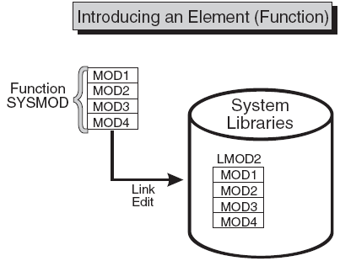
Function SYSMOD…
Notes:
When we refer to installing a function SYSMOD, we are referring to the placement of all the product's elements in the system data sets, or libraries. Examples of these libraries are SYS1.LPALIB, SYS1.MIGLIB, and SYS1.SVCLIB.
This slide shows the process of creating executable code in the production system libraries. Here, we see the installation of a function SYSMOD link-edits object modules MOD1, MOD2, MOD3, and MOD4 to create load module LMOD2. The executable code created in load module LMOD2 is installed in the system libraries through the installation of the function SYSMOD.
There are two types of function SYSMODs:
A base function SYSMOD adds or replaces an entire system function. Examples of base functions are SMP/E and JES2.
A dependent function SYSMOD provides an addition to an existing system function. It is called dependent because its installation depends upon a base function already being installed. Examples of dependent functions are the language features for SMP/E.
Both base function SYSMODs and dependent function SYSMODs are used to introduce new elements into the system. The textbook shows an example of a simple function SYSMOD that introduces four elements.

Slide 11
Preventing or fixing problems with an element
When a problem with a software element is discovered, IBM supplies its customers with a tested fix for that problem.
This fix comes in the form of a program temporary fix (PTF).
The PTF SYSMOD is used to install the PTF.
Notes:
When a problem with a software element is discovered, IBM supplies its customers with a tested fix for that problem. This fix comes in the form of a program temporary fix or PTF. Although you may not have experienced the problem the PTF is intended to prevent, it is wise to install the PTF on your system. The PTF SYSMOD is used to install the PTF, thereby preventing the occurrence of that problem on your system.
Usually, PTFs are designed to replace or update one or more complete elements of a system function.
PTF SYSMODs are always dependent upon the installation of a function SYSMOD. In some cases, some PTF SYSMODs may also be dependent upon the installation of other PTF SYSMODs. These dependencies are called prerequisites.

Slide 12
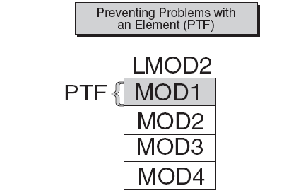
PTF SYSMOD…
Notes:
This slide shows a previously installed load module, LMOD2. If we want to replace the element MOD1, we should install a PTF SYSMOD that contains the module MOD1. That PTF SYSMOD replaces the element in error with the corrected element. As part of the installation of the PTF SYSMOD, SMP/E relinks LMOD2 to include the new and corrected version of MOD1.

Slide 13
Fixing problems with an element
Suppose you need to correct a serious problem that occurs on your system before a PTF is ready for distribution? Here, IBM supplies you with an authorized program analysis report or APAR.
An APAR is a fix designed to quickly correct a specific area of an element or replace an element in error. Installing an APAR SYSMOD updates the incorrect element.
The APAR SYSMOD “pre-reqs” a function SYSMOD. Also, it can require the installation of other PTF or APAR SYSMODs.
Notes:
You may sometimes find it is necessary to correct a serious problem that occurs on your system before a PTF is ready for distribution. In this situation, IBM supplies you with an authorized program analysis report or APAR. An APAR is a fix designed to quickly correct a specific area of an element or replace an element in error. You install an APAR SYSMOD to implement a fix, thereby updating the incorrect element.
The APAR SYSMOD always has the installation of a function SYSMOD as a prerequisite, and can also be dependent upon the installation of other PTF or APAR SYSMODs.

Slide 14
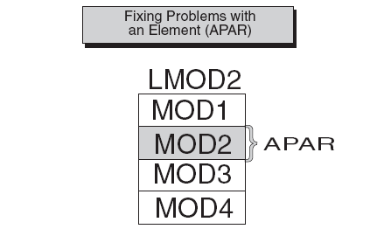
APAR SYSMOD…
Notes:
In this slide, the shaded section shows an area of MOD2 containing an error. The processing of the APAR SYSMOD provides a modification for object module MOD2. During the installation of the APAR SYSMOD, MOD2 is updated (and corrected) in load module LMOD2.

Slide 15
Customizing an element
z/OS provides certain modules that allow you to tailor IBM code to meet your specific needs.
The USERMOD SYSMOD can be used to replace or update an element, or to introduce a totally new user-written element into the system.
USERMOD SYSMOD pre-reqs: a function SYSMOD, and possibly other PTF, APAR, or USERMOD SYSMODs.
Notes:
If you had a requirement for a product to perform differently from the way it was designed, you might want to customize that element of your system. IBM provides you with certain modules that allow you to tailor IBM code to meet your specific needs. After making the desired changes, you add these modules to your system by installing a USERMOD SYSMOD. This SYSMOD can be used to replace or update an element, or to introduce a totally new user-written element into the system. In either case, the USERMOD SYSMOD is built by you either to change IBM code or to add your own code to the system.
Prerequisites for USERMOD SYSMODs are the installation of a function SYSMOD, and possibly the installation of other PTF, APAR, or USERMOD SYSMODs.

Slide 16
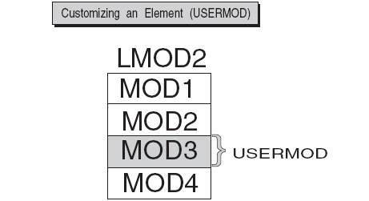
USERMOD SYSMOD…
Notes:
In this slide, MOD3 has been updated through the installation of a USERMOD SYSMOD.

Slide 17
Keeping track of the elements of the system
Some reasons for tracking system elements:
  A PTF might contain many element replacements that pre-req other SYSMODs.
  The same module might be part of many different load modules. If so, that module must be replaced in all the load modules in which it exists.
SMP/E relies on modification identifiers to identify elements and their various modifications and updates.
Three modification identifiers are associated with each element:
  Function Modification Identifiers (FMIDs)
  Replacement Modification Identifiers (RMIDs)
  Update Modification Identifiers (UMIDs),
Notes:
The importance of keeping track of system elements and their modifications becomes readily apparent when we examine the z/OS maintenance process. Often, a PTF contains multiple element replacements. Another important reason to track system elements is that the same module is often part of many different load modules. [The textbook shows examples of why it necessary to track system updates.]
To track and control elements successfully, all elements and their modifications and updates must be clearly identified to SMP/E. SMP/E relies on modification identifiers to accomplish this.
There are three modification identifiers associated with each element:
Function Modification Identifiers (FMIDs) identify the function SYSMOD that introduces the element into the system.
Replacement Modification Identifiers (RMIDs) identify the last SYSMOD (in most cases a PTF SYSMOD) to replace an element.
Update Modification Identifiers (UMIDs) identify the SYSMOD that an update to an element since it was last replaced.
SMP/E uses these modification identifiers to track all SYSMODs installed on your system. This ensures that they are installed in the proper sequence. Now that we realize the need for element tracking and know the types of things SMP/E tracks, let's look at how SMP/E performs its tracking function.

Slide 18
How does SMP/E work?
Where changes are kept:
  Distribution libraries -- contain all the elements that are used as input for running your system. Also important for backup.
  Target libraries -- contain the executable code needed to run the system.
  consolidated software inventory (CSI) -- contains information about the structure of a z/OS system.
  The CSI contains entries for the elements in the distribution and target libraries, grouped into zones:
    Distribution zone
    Target zone
    Global zone
Notes:
To properly perform its processing, SMP/E must maintain a great deal of information about the structure, content, and modification status of the software it manages.
Distribution libraries contain all the elements, such as modules and macros, that are used as input for running your system. One very important use of the distribution libraries is for backup. Should a serious error occur with an element on the production system, the element can be replaced by a stable level found in the distribution libraries.
Target libraries contain the executable code that is needed to run the system.
The consolidated software inventory (CSI) data sets contain all the information SMP/E needs to track the distribution and target libraries. In the CSI, entries for the elements in the distribution and target libraries are grouped according to their installation status. That is, entries representing elements found in the distribution libraries are contained in the distribution zone. Entries representing elements found in the target libraries are contained in the target zone. Both of these zones serve the same purpose as the drawers of the public library card catalog.
In addition to the distribution and target zones, the SMP/E CSI also contains a global zone. The global zone contains:
Entries needed to identify and describe each target and distribution zone to SMP/E
Information about SMP/E processing options
Status information for all SYSMODs SMP/E has begun to process
Exception data for SYSMODs requiring special handling or that are in error.
System programmers can also use the CSI data sets to obtain the latest information on the structure, content, and status of the system. SMP/E provides this information in reports, listings, and dialogs to help you:
Investigate function and service levels
Understand intersections and relationships of SYSMODs (either installed or waiting to be installed)
Build job streams for SMP/E processing

Slide 19
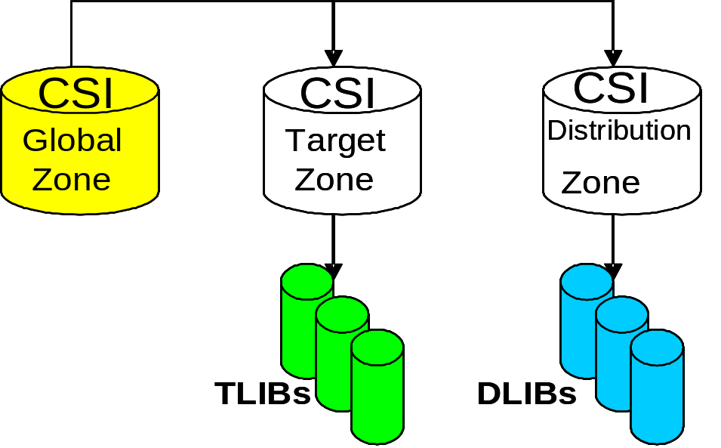
Relationship between SMP/E zones and libraries…
Notes:
This slide shows the relationship between SMPE zones and libraries.
Side note: In SMP/E, when we speak of exception data, we are usually referring to HOLDDATA. HOLDDATA is often supplied for a product to indicate a specified SYSMOD should be held from installation. Reasons for holding a SYSMOD can be:
A PTF is in error and should not be installed until the error is corrected (ERROR HOLD).
Certain system actions may be required before SYSMOD installation (SYSTEM HOLD).
The user may want to perform some actions before installing the SYSMOD (USER HOLD).
Now you can see how all the elements of the system fit together, and how they can be installed, modified, and tracked using SMP/E.

Slide 20
Working with SMP/E
The SMP/E process is performed by three simple basic commands:
RECEIVE – place a SYSMOD into the SMP/E library and create the CSI entries for them.
APPLY -- specifies which of the received SYSMODs are to be selected for installation in the target libraries (TLIBs). SMP/E also ensures that all other required SYSMODs (prerequisites) have been installed in the proper sequence.
ACCEPT -- takes the selected SYSMODs and installs them into the associated distribution libraries. SMP/E also ensures that the correct functional level of each element is selected.
Notes:
Now that you are familiar with SMP/E and what it can do, you are probably wondering what you need to know to get started using SMP/E. The SMP/E process is performed by three simple basic commands, (RECEIVE, APPLY, ACCCEPT). Let's take a look at these commands.
[Here, briefly explain the use of each of these SMP/E commands. The textbook contains more detailed descriptions and examples of their use.]
The RECEIVE command allows you to take a SYSMOD that is outside of SMP/E and stage it into the SMP/E library domain which begins to construct the CSI entries that describe them. This allows them to be queried for input into later processes. More recently the source can be electronic from a Web site, although usually it comes from a tape or even a third party vendor media.
The APPLY command specifies which of the received SYSMODs are to be selected for installation in the target libraries (TLIBs). SMP/E also ensures that all other required SYSMODs (prerequisites) have been installed or are being installed concurrently as well as in the proper sequence. The source of the elements is the SMPTLIB data sets, the SMPPTS data set or indirect libraries depending on how is was packaged. This phase of the SMP/E process entails:
Executing the appropriate utility to install the SYSMOD into the target library depending on the type of input text supplied and target module being changed.
Ensuring the relationship of the new SYSMOD is correct with other SYSMODs in the target zone.
The CSI is modified displaying the updated modules.
When a SYSMOD is installed into its target library, and you have tested it, you then accept the change through the ACCEPT command. This step takes the selected SYSMODs and installs them into the associated distribution libraries. On the ACCEPT command, you specify operands to indicate which of the received SYSMODs are to be selected for installation. During this phase, SMP/E also ensures that the correct functional level of each element is selected.

Slide 21
Other data sets used by SMP/E
SMPPTS (PTS) - temporary storage of SYSMODs waiting to be installed.
SMPSCDS (SCDS) - backup copies of target zone entries modified during APPLY processing.
SMPMTS (MTS) - stores copies of macros during installation
SMPSTS (STS) -stores copies of source during installation
SMPLTS (LTS) – stores the base version of a load module
Other utility and work data sets.
Notes:
An SMPPTS (PTS) data set is a data set for temporary storage of SYSMODs waiting to be installed. The PTS is used strictly as a storage data set for SYSMODs. The RECEIVE command stores SYSMODs directly on the PTS without any modifications of SMP/E information. The PTS is related to the global zone in that both data sets contain information about the received SYSMODs. Only one PTS can be used for a given global zone. Therefore, you can look at the global zone and the PTS as a pair of data sets that must be processed (for example, deleted, saved, or modified) concurrently.
The SMPSCDS (SCDS) data set contains backup copies of target zone entries modified during APPLY processing. Therefore, each SCDS is directly related to a specific target zone, and each target zone must have its own SCDS. SCDS data sets are used by SMP/E to store backup copies of target zone entries modified during APPLY processing. Therefore, each SCDS is directly related to a specific target zone, and each target zone must have its own SCDS.
SMP/E also uses the following data sets:
The SMPMTS (MTS) data set is a library in which SMP/E stores copies of macros during installation when no other target macro library is identified. Therefore, the MTS is related to a specific target zone, and each target zone must have its own MTS data set.
The SMPSTS (STS) data set is a library in which SMP/E stores copies of source during installation when no other target source library is identified. Therefore, the STS is related to a specific target zone, and each target zone must have its own STS data set.
The SMPLTS (LTS) data set is a library that maintains the base version of a load module. The load module in this library specifies a SYSLIB allocation in order to implicitly include modules. Therefore, the LTS is related to a specific target zone, and each target zone must have its own LTS data set.
Other utility and work data sets.

Slide 22
Summary
  In z/OS, the primary means for managing changes to the system software is through SMP/E.
  SMP/E can be run either using batch jobs or using dialogs
  Software to be installed must be packaged as system modifications or SYSMODs
  SMP/E JCL and commands are used frequently by system programmers
  The product and SYSMOD packaging will include the necessary MCS statements
  A critical responsibility of the system programmer is to work with IBM defect support when a problem surfaces in z/OS or option IBM products
  Problem resolution will require the system programmer to receive and apply fixes to the enterprise system.
Notes:
As a z/OS system programmer, it will be your responsibility to ensure that all software products and their modifications are properly installed on the system. On z/OS, the primary means for managing changes to the system software is through SMP/E.
SMP/E can be run either using batch jobs or using dialogs under Interactive System Productivity Facility/Program Development Facility (ISPF/PDF). With SMP/E dialogs, you can interactively query the SMP/E database and create and submit jobs to process SMP/E commands.
Software to be installed by SMP/E must be packaged as system modifications or SYSMODs, which combine the updated element with control information. This information describes the elements and any relationships the software has with other products or service that may also be installed on the same system.
The SMP/E JCL and commands will be used frequently by a large enterprise z/OS system programmer, however, SMP/E MCS instructions will rarely be coded by the same system programmer. The product and SYSMOD packaging will include the necessary MCS statements.
A critical responsibility of the system programmer is to work with IBM defect support when a problem surfaces in z/OS or option IBM products. Problem resolution will require the system programmer to receive and apply fixes to the enterprise system.

